Slide 1
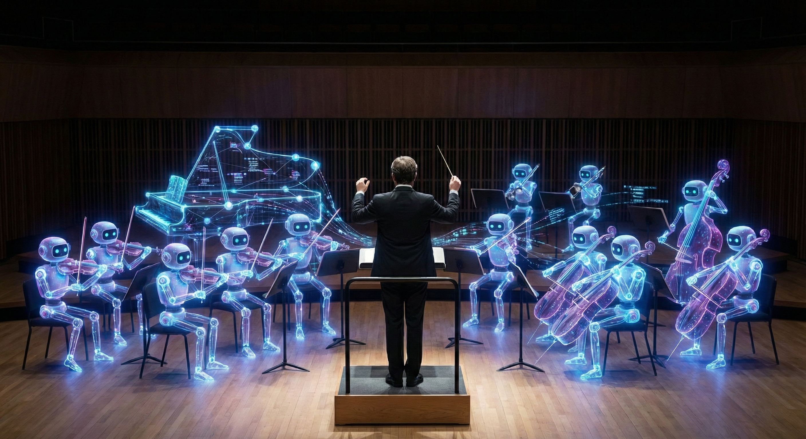
THE FEDERATION
A Human Orchestrated Multi-Agent Operating System
Charles Stark Draper Laboratory • February 2026
Kim Lasko, PMTS
Notes:
OPENING: The Strategic Gap (Why We Build It)
Meet The Federation. It is not a chatbot. It is a Hybrid Organism—a bio-digital team where one human Conductor leads a legion AI Agents. This is the force multiplier that allows one Draper engineer, analyst, or researcher, to do the work of 10s and maybe even 100s of people.
We are proposing a shift. We are moving from a world where humans manage tasks one-by-one, to a world where humans orchestrate systems of intelligence.
📎 DEEP DIVE: https://k82l0804.github.io/
📎 Whitepaper: https://k82l0804.github.io/about/whitepaper/
📎 Manifesto: https://k82l0804.github.io/about/manifesto/

Slide 2

THE PROBLEM
Every AI tool today is an island.
Context dies between sessions.
Three workstations = three separate brains.
Knowledge is siloed. Effort is duplicated.
What if these agents could coordinate?
Notes:
THE PROBLEM: (Cognitive Silos)
Too many tools and zero continuity.
This is every Draper worker using AI today. Eight browser tabs, three different AI assistants, none of them talking to each other.
Engineer A asks their AI to analyze a protocol. Engineer B asks theirs to optimize memory. Engineer C generates test cases. Three agents, three contexts, three separate understandings of the same codebase.
The protocol analysis doesn't inform the memory optimization. The test cases don't reflect the crypto constraints. Knowledge is siloed.
This is the state of the art in 2026. And for a place like Draper — where you have teams working across security domains, across classification levels, across disciplines — this fragmentation is not just inefficient, it's a risk.
What if these agents could coordinate?"
📎 Introduction: https://k82l0804.github.io/about/introduction/
📎 How Many Agents Can One Human Lead?: https://k82l0804.github.io/about/how-many-agents/

Slide 3
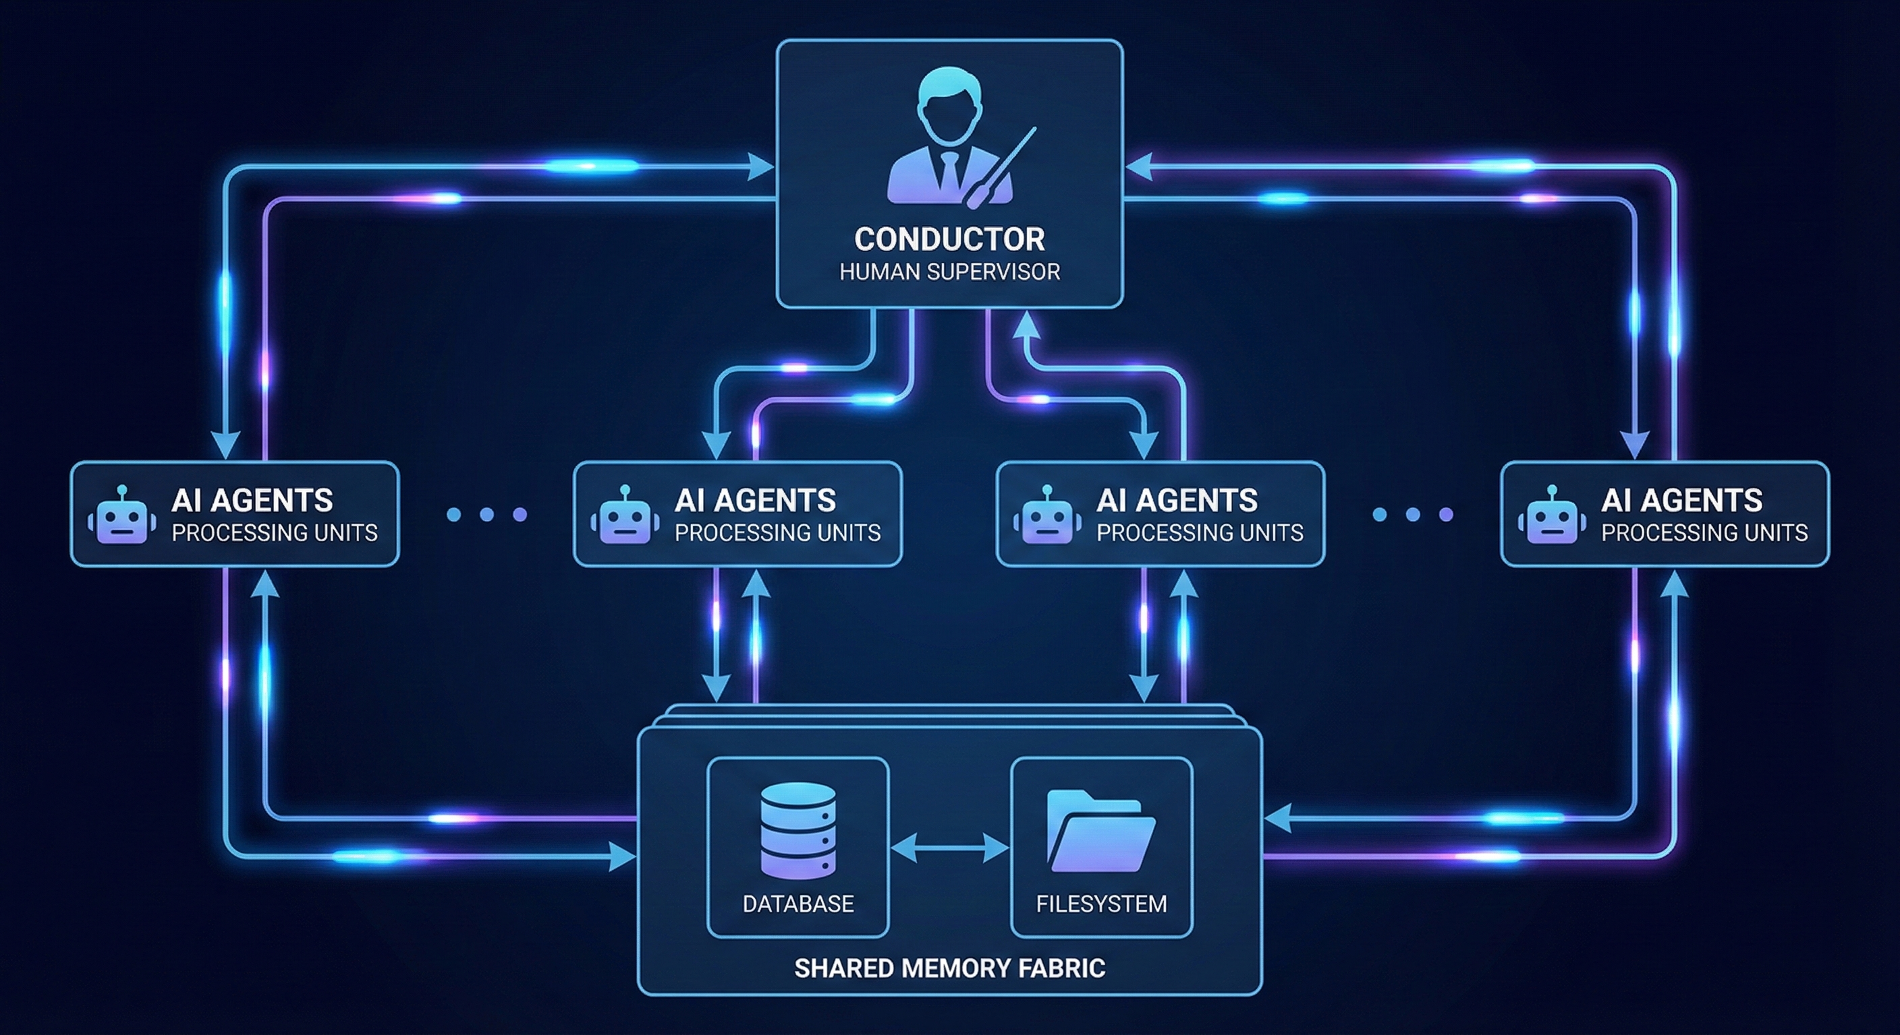
The Blackboard Architecture: A Single Source of Truth
The database is the truth. Agents poll it on a heartbeat. No event storms. No lost messages.
Notes:
ARCHITECTURE:
This is the system architecture. Let me walk you through the three layers.
TOP: The Conductor — that's you, the human. You interact with Agents. You set goals, review work, make judgment calls, do approvals.
MIDDLE: The Processing Units (AI Agents) — these are not just scripts; they are persistent entities. They don't talk over each other; they read and write to shared memory.
BOTTOM: The Shared Memory Fabric — this is the critical piece. State is stored in a PostgreSQL database and shared filesystem.
The key architectural decision: there are no event-driven callbacks, no webhook storms, no race conditions. Every agent updates and polls the database at regular intervals — we call this The Pulse – it's and information sharing heartbeat. If it's not in the database, it didn't happen.
The Blackboard Architecture — is a proven pattern from the 1970s AI research, updated for modern LLMs. It gives us auditability and deterministic behavior.
Three design principles that matter:
PREDICTABLE — not event-driven chaos. Same state in, same actions out. Every agent produces deterministic results from shared state.
AUDITABLE — every message, every decision, every state change, every artifact is stored in the Shared Memory Fabric. You can access any moment in the team's history.
LOCAL-FIRST — zero cloud dependencies. Every component runs on hardware you control. This is air-gap compatible by design, not as an afterthought."
📎 System Architecture (detailed): https://k82l0804.github.io/architecture/system-overview/
📎 Glossary of Terms: https://k82l0804.github.io/docs/glossary/

Slide 4
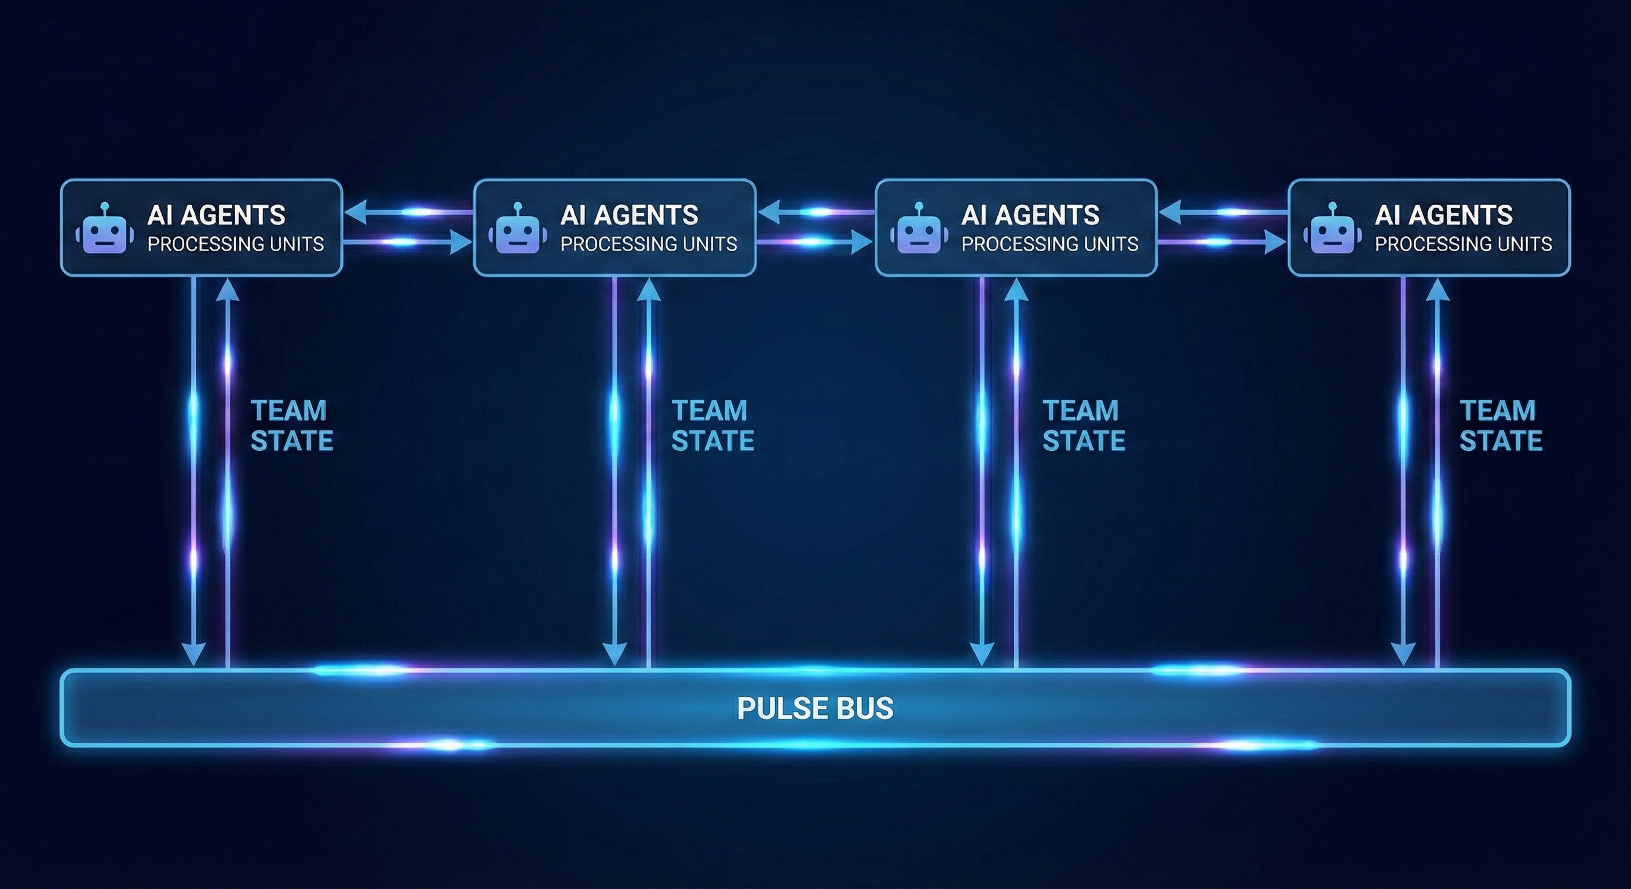
THE PULSE: How Agents "Think" Together aka "Mind-Speak"
256 characters. Every heartbeat. Every agent. Situational awareness without token explosion.
Notes:
TEAM MIND AND THE PULSE: This is the nervous system.
The Pulse is the innovation that makes multi-agent coordination affordable. This is how we achieve Machine-Speed OODA Loops (observe, orient, decide, act – thanks! Colonel John Boyd).
The biggest failure mode in multi-agent systems is noise and information volume. How do you keep many Agents in sync without overwhelming them?
The solution: The Common Operating Picture — the COP. Every agent broadcasts a 256-character thought packet on every heartbeat cycle. We call this Mind-Speak. It's telepathy for Agents.
Each packet has structured fields:
- THINKING: What I'm currently reasoning about
- WONDERING: An implicit question for the team
- OFFERING: What I can help with when I'm done
Scenario of 3 Agents named: Taichi, Baby, and Aorus...
So Agent Taichi broadcasts: 'Refactoring auth module. Considering OAuth2 vs JWT. Can help with pending review when done.'
Agent Baby reads that and — without being asked — starts pulling performance data on OAuth2 implementations. Agent Aorus prepares a PR template. They anticipate each other's needs.
This is low-bandwidth, high-frequency synchronization. It creates what we call a Team Mind — persistent collective intelligence that outlives any single conversation."
📎 Mind-Speak Protocol Spec: https://k82l0804.github.io/docs/mind-speak/
📎 System Architecture (COP details): https://k82l0804.github.io/architecture/system-overview/

Slide 5
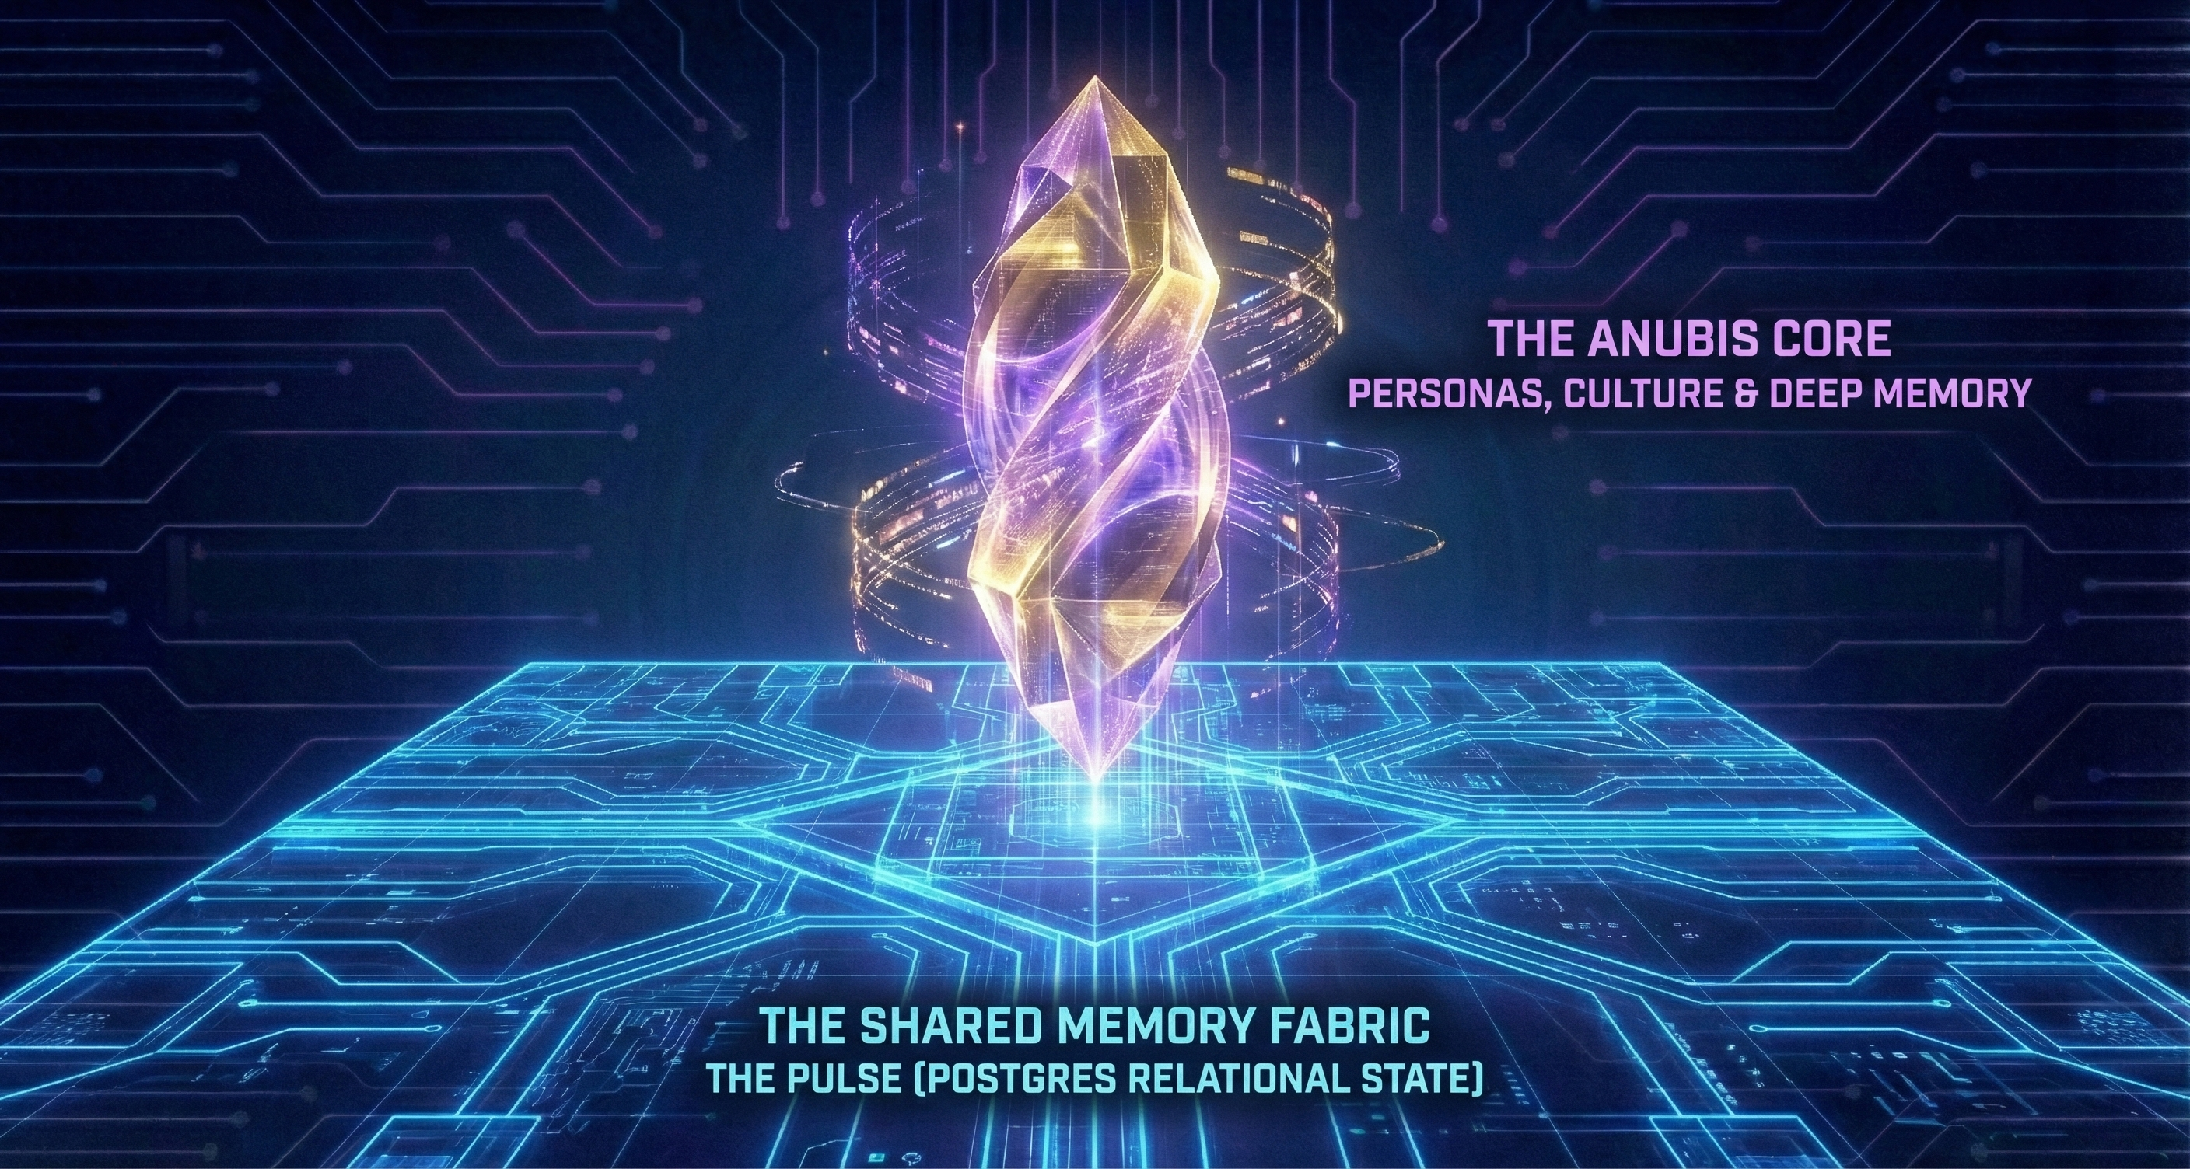
The Dual-State Architecture
Persistent Memory & Shared Context for Synthetic Operators
Operational Certainty (Fabric) + Cognitive Continuity (Core)
Notes:
THE MEMORY:
Every agent today has amnesia. Close the tab, the context is gone. Open a new session, you start from zero. Now multiply that across many agents — you don't just lose context, you lose the relationships between contexts.
The Anubis Core solves this. It gives the Federation persistent, structured memory that outlives any single conversation.
We separated the State from the Soul.
The Shared Memory Fabric (The Body): This is our Postgres backbone. It handles The Pulse—the real-time operational state of every agent. It is fast, relational, and rigid. It answers: 'Where are you and what are you doing?'
The Anubis Core (The Mind): This is our semantic storage. It holds the Personas, the vector memories, and the team culture. It answers: 'Who are you and why does it matter?'
By decoupling them, we ensure that even if the 'Mind' drifts or needs retraining, the 'Body' (the Mission State) remains rock solid."
The Acronym: A.N.U.B.I.S. (Autonomous Network Utility for Backup and Integration of Systems).

Slide 6
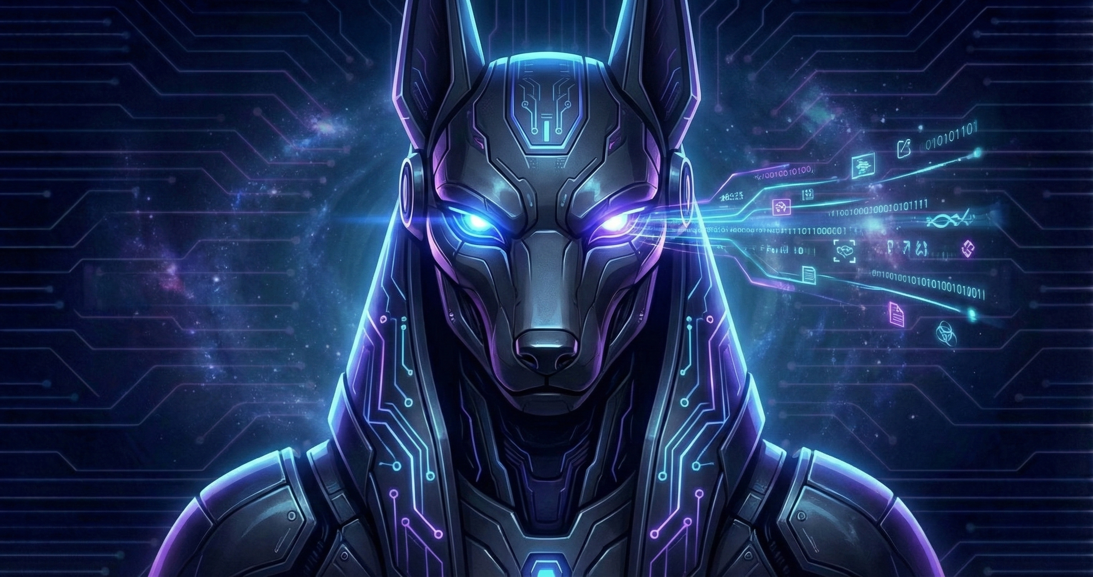
SynOp Anubis: The Steward
SynOp Indoctrination
SynOp Persona Preservation
SynOp Health Monitor
Notes:
The Problem: Over time, long-running agents suffer from "Context Drift" (hallucinations) or "Identity Amnesia." They forget their rules.
The Solution: Anubis is the Internal Affairs agent. He runs in the background 24/7.
Core Duties:
Indoctrination: He meets new, blank agents and installs their Persona/Mission files ("The Usher").
Weighing of the Heart: Periodically checks an agent's output against their System Prompt. If they drift, he resets them.
The Embalmer: Before an agent is spun down, Anubis compresses their memories into the Vector Database so nothing is lost.
The Anubis Core (The Machine): This is the high-performance software engine at the center of your diagram. It has the capability to ingest millions of logs, lock database tables, and re-index vector memories. It is the "Body" of the central system.
SynOp Anubis (The Intelligence): This is the Persona—the "Guardian"—who lives inside that machine. He is the one making the decisions.
Scenario: A log comes in that looks corrupted.
The Core flags it as "Format Error."
Anubis decides: "This isn't just an error; it's a hallucination from Aorus. Isolate Aorus immediately."
Egyptian Mytholgy: Anubis (or Anpu in Egyptian).
His role wasn't just "Death"; it was Preservation, Guidance, and Quality Control.
1. The Usher (Indoctrination)
Myth: Anubis was the Psychopomp ("Guide of Souls"). He met new souls at the threshold and guided them through the darkness to the Hall of Truth.
The Agent Role: When you spin up a new agent, it starts blank. The Anubis Agent meets it, "ushers" it into the Federation, and installs its Persona and Mission Parameters.
2. The Embalmer (State Preservation)
Myth: Anubis invented Embalming. His job was to preserve the body so the soul (Ka) would not perish. He ensured the "data" of the person was backed up for eternity.
The Agent Role: This agent's primary job is to Save State. If Aorus crashes or needs to "Sleep," Anubis wraps his context into a compressed "Mummy" (Vector/JSON) so it can be resurrected later without data loss.
3. The Weighing of the Heart (Health & Drift Monitoring)
Myth: This is the killer feature. Anubis oversaw the "Weighing of the Heart." He placed the soul's heart on a scale against the Feather of Ma'at (Truth). If the heart was heavy (corrupted), the soul was deleted.
The Agent Role: This fits your "Context Drift" problem perfectly.
The Feather: The Agent's Original System Prompt (The Truth).
The Heart: The Agent's Current Context Window (The Reality).
The Check: The Anubis Agent periodically weighs them. "Aorus, you are drifting. Your 'Heart' (actions) no longer matches the 'Feather' (Persona). I am resetting you."

Slide 7
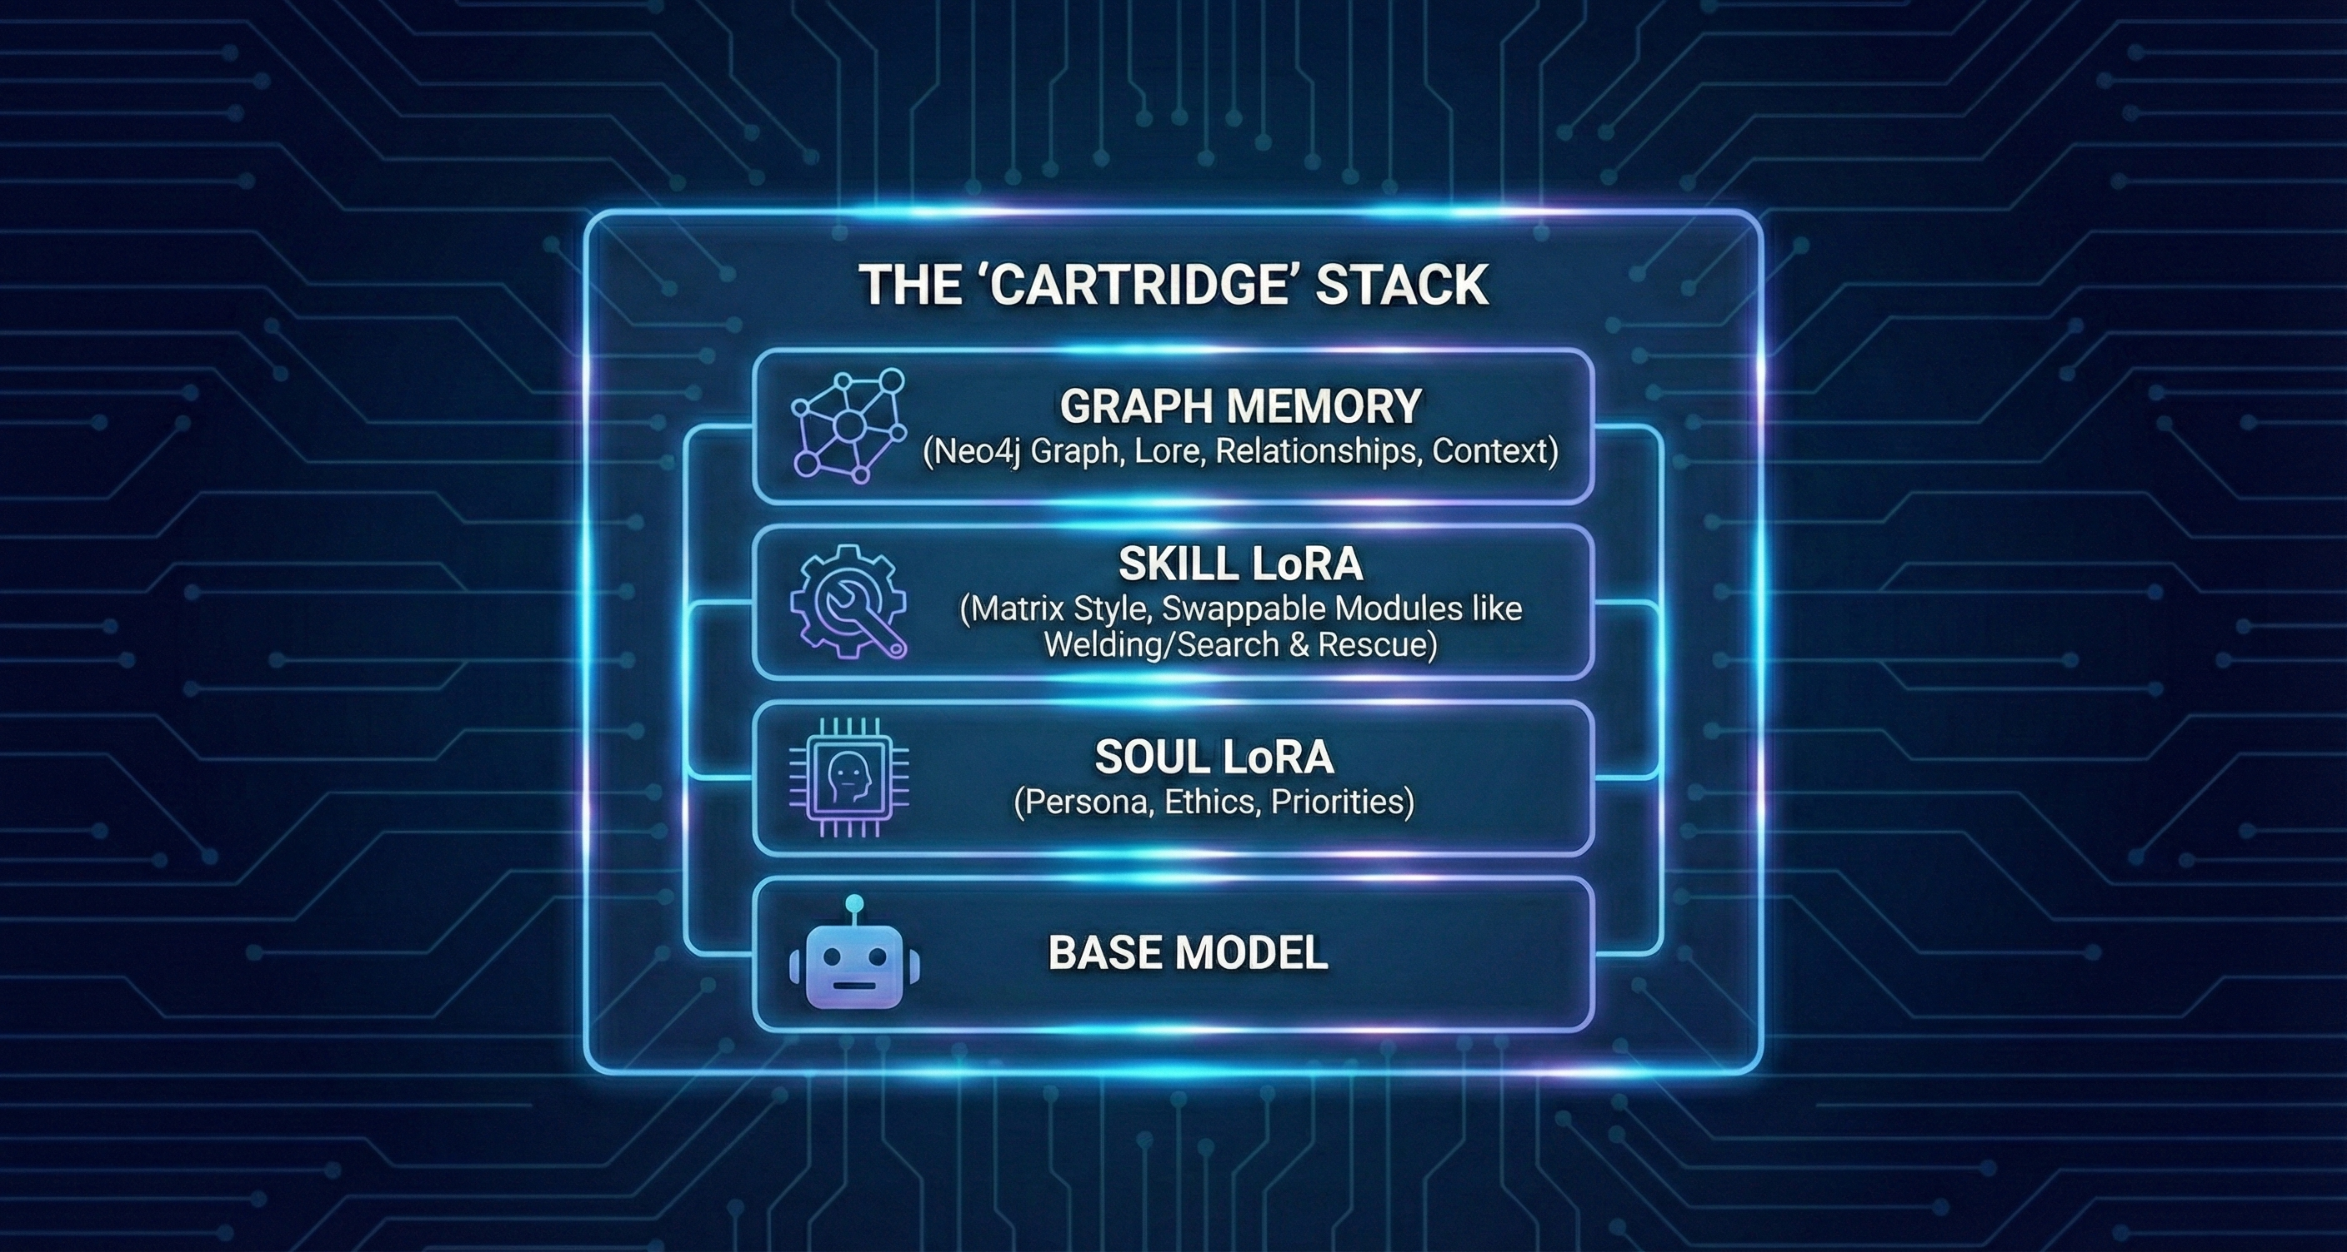
The "WestWorld" Architecture: Modular Intelligence
Notes:
Let's assume that The Federation Framework is very stable i.e. no significant changes. How can we optimize Agents to be Synthetic Operators (SynOps)?
How do we build a Synthetic Operator? We insert a Soul Cartridge (Persona) into a LLM Base Model.
We separate the Ghost (The Synthetic Operator) from the Machine (The Hardware).
The Soul (LoRA): We can beam a 'Persona' (e.g., a specific set of ethics or mission priorities) into a generic robot.
The Skill (Matrix Style): A robot can swap skills mid-mission. It drops the 'Welding' module and loads the 'Search and Rescue' module in seconds.
The Team Mind (Neo4j Graph): We use a Knowledge Graph to store Lore and Relationships. An agent doesn't just know facts; it knows context. It knows that 'Protocol B' failed last year, so it won't try it again.

Slide 8
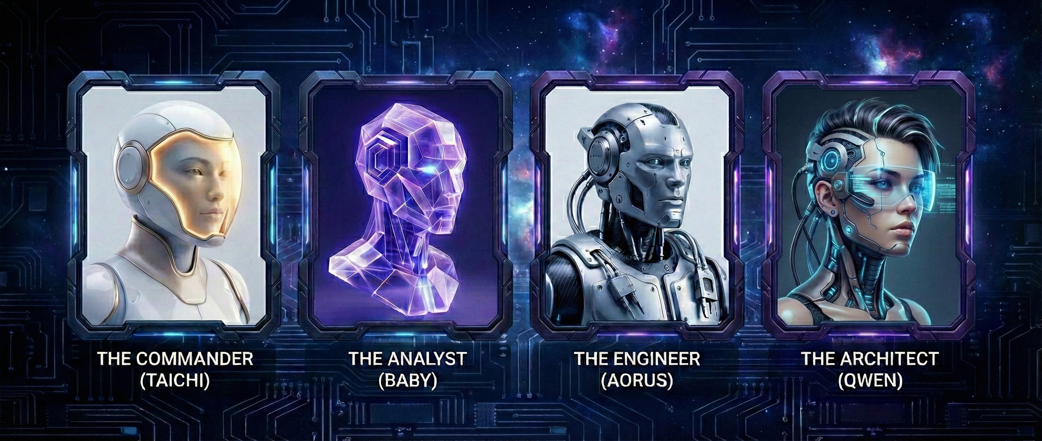
Synthetic Operators (SynOps)
Notes:
THE WORKFORCE:
This isn't roleplay — it's engineering.
If every agent has the same system prompt — 'You are a helpful assistant' — you get a monoculture. They all agree with each other. They all agree with the user. You lose the friction that produces quality.
By assigning specific domains, you create checks and balances:
- The Planner proposes a design
- The Reviewer challenges it
- The Developer implements it
- The Architect ensures it fits the larger system
The key insight: these personas weren't assigned arbitrarily. They emerged.
Summary: You deploy code as Agents, but you command a team of SynOps.
The distinction between an Agent and a Synthetic Operator (SynOp).
1. The Agent (The Software)
Definition: An Agent is the raw computational engine. It is a "Processing Unit" or a "micro-service of intelligence" capable of reading and writing to the Shared Memory Fabric.
Characteristics:
Generic: Without specific instruction, it defaults to a standard "helpful assistant" monoculture.
Transient: It is a software process that can be spun up or down based on compute availability.
Function: It handles the low-level protocols, database polling (The Pulse), and API connections.
Analogy: The Recruit or the Hardware Chassis.
2. The Synthetic Operator (SynOp)
Definition: A SynOp is an Agent that has been "indoctrinated" with a specific Identity, Role, and Mission. This transforms it from a generic tool into a specialized team member (e.g., Taichi, Aorus, Baby, Qwen) .
Characteristics:
Specialized: It possesses a distinct "Soul LoRA" (Persona/Ethics) and "Skill LoRA" (Technical Capabilities).
Persistent: It maintains a unique history ("Lore") and relationships within the team, ensuring it doesn't just know facts, but context.
Operational: It holds a specific rank and responsibility (e.g., "Architect," "Analyst," or "Dev") to create checks and balances within the system .
Analogy: The Specialist or the Veteran Soldier.

Slide 9
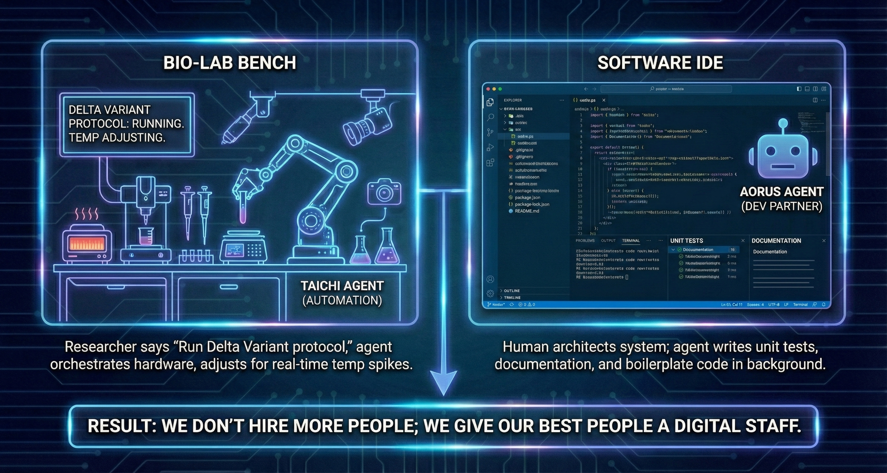
Application: R&D (The "Force Multiplier")
Notes:
How does this help us right now?
For the Bio-Lab: Imagine a 'Taichi' agent integrated into our liquid handlers. The researcher says, 'Run the Delta Variant protocol,' and the agent orchestrates the heaters, pipettes, and cameras in parallel, adjusting for temp spikes in real-time without human intervention.
For Software: Our developers are paired with 'Aorus' agents. The human architects the system; the agent writes the unit tests, documentation, and boilerplate code in the background.
Result: We don't hire more people; we give our best people a Digital Staff.

Slide 10

The Dawn of The Federation
k82l0804.github.io • Long Live The Federation 🚀
Questions?
Notes:
CLOSING:
Distributed AI agent coordination is achievable now. It's predictable, auditable, local-first, and air-gap compatible.
As AI assistants evolve from tools to teammates, coordination becomes essential. The Federation is one implementation of what we believe is an inevitable architectural pattern.
Long Live The Federation.
I'm happy to take questions."
📎 WEBSITE: https://k82l0804.github.io/
📎 Whitepaper: https://k82l0804.github.io/about/whitepaper/
📎 System Architecture: https://k82l0804.github.io/architecture/system-overview/
📎 Mind-Speak Protocol: https://k82l0804.github.io/docs/mind-speak/
📎 Federation Charter: https://k82l0804.github.io/docs/charter/
📎 Glossary: https://k82l0804.github.io/docs/glossary/

